Slide 1
Video Game Analysis &
Technical Design
  Ch.5 Simulation, Adventure, Puzzle and Online Games

Slide 2
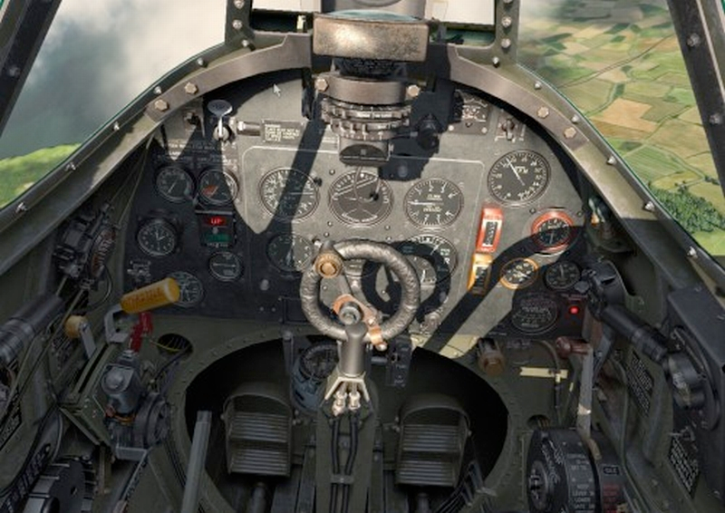
What Are Vehicle Simulations?

Slide 3
What Are Vehicle Simulations?
Feels like driving, flying, or controlling a vehicle
Simulations vary from realistically handling the vehicle to adding game mechanics such as combat, racing, and special challenges
Space and water vehicle simulations follow the same fundamental features as flying and driving simulations

Slide 4
Game Features
Flight simulators
  Civilian flight simulators are realistic and don’t include combat
  Military flight simulators are simplified but provide tactical conflict as well as physical challenges
Driving simulators
  Organized racing is driving in an existing racing class; requires licensing
  Imaginary racing uses imaginary situations

Slide 5
Game Features
Players
  Purists demand highly accurate simulations of real vehicles
  Casual players don’t care about the details as long as they can fly or drive

Slide 6
Game Features
The player’s role
  Flight simulators
    Pilot or military positions such as navigator or bombardier
  Racing-oriented driving games
    Driver or mechanic

Slide 7
Game Features
Competition modes
  Military flight simulators
    Similar to first-person shooters
  Civilian flight simulators
    Single-player mode
  Driving simulators
    Single-player games or multiplayer races
  Military flight simulators and organized race-driving simulators
    Often include career mode and campaign mode

Slide 8
Game Features
Gameplay and victory conditions
  Primary challenge is controlling the vehicle
  Military flight sims must also achieve the mission objective
    Type of plane determines gameplay
    Many offer a series of missions
  Civilian flight sims seldom have victory conditions
  Organized racing sims take gameplay from the real races

Slide 9
Core Mechanics
Vehicle simulations are technologically oriented, so the core mechanics are almost entirely about physics
Designing opponents
  Provide different vehicles with different characteristics
  Modify the behavior of individual opponents

Slide 10
Core Mechanics
Damage
  Children’s games can ignore damage to the vehicle
  Damage can be modeled as a single variable like health points
  Accurate modeling divides the vehicle into areas
    Tracks damage in each individual area
    Computes damage’s effect on vehicle performance

Slide 11
The Game World
Landscape is an important part of the entertainment
Flight simulators
  Setting is the plane and the ground
Driving simulators
  Racetrack, road, or off-road
Weather affects vehicle handling
Consider adding people to racetracks and airports to enhance immersion

Slide 12
Other Vehicles
Boats and ships
  Fluid medium changes handling characteristics, making it different from driving simulators
  Large warships simulated as parts of fleets
  Submarines are popular simulations
  Sailing simulations are rare
  Ocean is not modeled accurately
    Shoreline is usually correct
    Depth, tides, currents, reefs are not

Slide 13
Other Vehicles
Tanks and mechs
  Rotating turret on tanks adds complexity
  Mech is an invented mechanism unrestricted by reality
Spacecraft
  Majority of spacecraft simulations are science fiction
  Not modeled accurately
    Similar to fighter planes

Slide 14
Intellectual Property Rights
Generally, you can simulate military equipment without obtaining permission from the manufacturers
To simulate an existing car or other civilian vehicle, you need a license from the manufacturer

Slide 15
The Presentation Layer
Interaction model
  Plane is the avatar; view through cockpit window
Perspective
  Views common to driving and flight simulators
    Pilot’s/driver’s view
      Default
    Cockpit-removed view
    Chase view
    Rear, side, and front views
    Free-roaming camera

Slide 16
The Presentation Layer
Perspective
  Views unique to military flight simulators
    Ground target view
    Bomb or missile view
  Views unique to driving simulators
    Track-side view
    Grandstand view
    Blimp view

Slide 17
The Presentation Layer
User interface design
  Biggest challenge is mapping vehicle’s real controls to those available on target machine
  Simplification
    Military simulators require some simplification
    Flight simulators commonly simplify navigation
  Most flight simulators produce automatically coordinated flight

Slide 18
The Presentation Layer
User interface design
  Creating the sense of speed
    Critical in driving simulations
      Display a speedometer
      Vary the driving surface
      Include roadside objects
      Use sounds
  G-forces
    Military planes can show a G-force meter
    Pilots can black out or red out

Slide 19
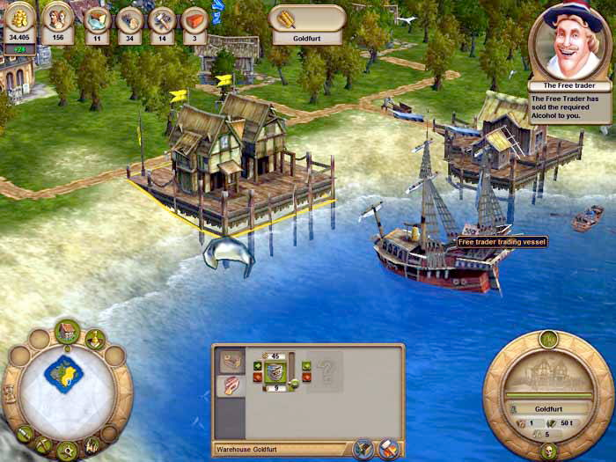
What Are Construction and Management Simulations?

Slide 20
What Are Construction and Management Simulations?
The majority of challenges are economic, concerned with growth
Construction activity is an essential element of any CMS
Pattern recognition and exploration challenges may also be present
CMSs avoid physical challenges, as well as conflict challenges, unless they are hybrids with another genre

Slide 21
Game Features
The player’s role
  It’s not easy to define the player’s role because that role seldom corresponds to an actual activity in real life
  The desire to create is in the heart of a CMS player

Slide 22
Game Features
Progression
  No levels or story
  Many begin with an empty space for players to start in from scratch
  Often have no victory condition, only loss
  Can also offer different scenarios for player to try
    Scenarios are partially built when player starts them
    Scenarios may have victory conditions as well as loss conditions

Slide 23
Game Features
Gameplay
  Majority of CMSs are games of indirect control
    The game simulates a process that the player can alter only in limited ways
    However, some actions, such as changing prices, use direct control
  Construction
    In most CMSs, actual act of construction is not a challenge
    Challenge is in obtaining resources needed for construction

Slide 24
Game Features
Gameplay
  Purchase-and-place construction mechanism
    Primary activity is construction
    Player can build objects quickly
    Resources used immediately
  Plan-and-build construction mechanism
    Player alternates between building and managing
    Player builds objects slowly
    Player must manage the resource flow

Slide 25
Game Features
Gameplay
  Demolition
    Allow players to demolish constructed items
    Select cost for demolition
Victory and loss conditions
  Many CMSs do not have victory conditions
  Loss condition is bankruptcy
  Scenarios can have victory conditions

Slide 26
Game Features
Competition modes
  Single-player unless it’s a hybrid
  Single-value variables track a character’s degree of happiness or unhappiness and a set of needs that the simulated character desires to fulfill.
Simulating individuals
  Many CMSs model behavior statistically for the group
  To model individuals, use single-value variables
  Modeling individuals is more difficult but the individuals create the statistical model

Slide 27
Game Features
Mind reading enables the player to see an individual’s needs and fulfillment status
Advisors
  Provide alerts about local problems
  Notify the player of general conditions
  Set a threshold level at which the advisor will appear
  Allow players to turn off the advisor to add to challenge

Slide 28
Game Features
Pure business simulations
  Players construct financial fortunes, not visible objects
  Challenge
    Devise an economy and mechanisms for manipulating it
  Real challenge is to make the subject visually interesting
  Avoid runaway profits by controlling when and how a player can buy and sell

Slide 29
Game Features
Hybrid games
  Offer economic, exploration, and conflict challenges
  Design the economic aspects before adding other elements

Slide 30
Core Mechanics
Resources
  Primary resources
    Money and people
  Building materials
    Tangible entities in plan-and-build mechanics
    Intangible or not a resource in purchase-and-build mechanics

Slide 31
Core Mechanics
The construction converter changes labor, money, and materials into buildings
Drains and maintenance
  Drain permanently removes a resource
  Decay is the usual drain
  Maintenance can be automated
Disasters force players to act

Slide 32
The Game World
Setting
  Simulated physical space, usually outdoors
  Aerial perspective
  Often set in 2D or 2.5D worlds
Pure business simulations might not require a physical setting

Slide 33
The Presentation Layer
Interaction model
  Player is usually multipresent
  Walkthrough mode allows players to see the world in first-person perspective
Perspective
  Isometric perspective is common
  3D environments allow players to zoom in and out, see a broad overview, or focus on a local problem

Slide 34
The Presentation Layer
User interface
  Interface can be more like standard computer software
  Display important scalar variables
  Graph can show values over time
  Vector variables describe related data, such as the amount of water available in different locations

Slide 35
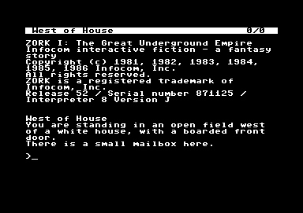
What Are Adventure Games?

Slide 36
What Are Adventure Games?
Interactive story about a protagonist
Storytelling and exploration are essential elements
Puzzle-solving and conceptual challenges form the majority of the gameplay
Combat, economic management, and action challenges are reduced or nonexistent

Slide 37
What Are Adventure Games?
The original Adventure
  Adventure was a text-only game
  First computer game to give the player a credible illusion of freedom
  First computer game that spoke to players like a person rather than a machine

Slide 38
What Are Adventure Games?
The growth of adventure games
  Very popular in the early days of personal computers
  Having no graphics made games inexpensive to develop and allowed scope for imagination
  Developers added graphics when the technology became available

Slide 39
What Are Adventure Games?
Adventure games today
  Market for adventure games has grown less steadily than the market for other genres
  Development of 3D hardware improved graphics in adventure games
  Action-adventure games developed
    This hybrid is now more popular than action or adventure
  Alternative solutions improves replayability
  Many players never complete the game

Slide 40
Game Features
Setting and emotional tone
  Setting contributes more to the entertainment value of an adventure game than settings in any other genre
  Games move slowly, which gives designers the chance to create a world with a distinct emotional tone

Slide 41
Game Features
Interaction model
  Always uses an avatar-based interaction model
  Early games used nonspecific avatar, but now avatar possesses his own personality
Perspective
  Context-sensitive approach is traditional
  Third- and first-person games are becoming increasingly common

Slide 42
Game Features
Perspective
  Context-sensitive perspective
    Avatar is shown from the camera angle most appropriate for her current location in the game world
    Lets the designer play cinematographer, using camera angles, composition, and lighting to enhance the story
  First-person perspective
    Encourages a more action-oriented approach to playing
    Fewer opportunities for visual drama

Slide 43
Game Features
Perspective
  Third-person perspective
    Keeps the avatar in view
    Common in action-adventure games
    Best games allow the player to move the camera

Slide 44
Game Features
Player roles
  Role of the player comes from the story
  Most adventure games treat the story as a journey
Structure
  Establish a relationship between locations in the world and parts of the story
  Story became more linear

Slide 45
Game Features
Storytelling
  Dramatic tension
    Arises from an unresolved situation or problem
    To create dramatic tension, start by presenting the problem
    The resolution of dramatic tension occurs at the dramatic climax, usually near the end of the story
    Adventure games can have several different dramatic climaxes for intermediate problems until the final climax solves the final problem and ends the story

Slide 46
Game Features
Storytelling
  The heroic quest
    The majority of adventure games are heroic quests: a mission by an individual to accomplish a great feat
    Biggest climax should be the last major climax in the game because anything that follows seems irrelevant
    Should be periods of quiet to rest and heal

Slide 47
Game Features
Storytelling
  The problem of death
    Most adventure games adopt a fair warning approach, making it clear when something is dangerous and usually offering a way to neutralize the danger
    Use an autosave feature to save the game at intervals so the player can restore it later

Slide 48
Game Features
Challenges
  Majority of challenges are conceptual: puzzles that can only be solved by lateral thinking
  Puzzles include
    Finding keys to locked doors
    Figuring out mysterious machines
    Obtaining inaccessible objects
    Manipulating people
    Navigating mazes
    Decoding cryptic messages
    Solving memorization puzzles
    Collecting things
    Doing detective work
    Understanding social problems

Slide 49
Game Features
Conversations with nonplayer characters (NPCs)
  An NPC’s conversation is defined by the NPC’s role, such as blacksmith or trader
  Some games try to sidestep the problem of conversation by setting games in underpopulated worlds
  Scripted conversations became standard

Slide 50
Game Features
Mapping
  Graphics provide cues to location and how that location relates to other areas in the world
  Automapping
    Map fills in as the player moves
  Player can see the map at any time
  Provide a compass as well if appropriate
Automatic journal keeping is common

Slide 51
Game Features
A few things to avoid
  Puzzles solvable only by trial and error
  Conceptual non sequiturs
  Illogical spaces
  Puzzles requiring outside knowledge
  Click-the-right-pixel puzzles
  Too many backward puzzles
  Too many FedEx puzzles

Slide 52
The Presentation Layer
Avatar movement
  Movement interface depends on the perspective
  Context-sensitive perspective uses point-and-click or direct control user interface
    Point-and-click
      Indirect control
    Direct control
      Player steers the avatar
  Implement both walk and run modes

Slide 53
The Presentation Layer
Manipulating objects
  Identifying active objects
    Hunt and click
    Permanently highlighted objects
    Dynamically highlighted objects
    Focus-of-attention highlighting

Slide 54
The Presentation Layer
Manipulating objects
  One-button actions
    Controller button or mouse click correctly manipulates the object
  Menu-driven actions
    Menu gives player the available choices
    Player can right-click an object to see a pop-up menu

Slide 55
The Presentation Layer
Manipulating objects
  Managing inventory
    Most games limit the amount that can be carried
    Visible inventory mechanism like a backpack or box is common
    Make inventory management easy
    Open and close inventory with a single click or shortcut key

Slide 56
Artificial Life Games
Artificial life is a branch of computer science research
A-life involves modeling biological processes
A-life is the study of emergent properties—unanticipated qualities or behaviors that arise out of the interactions of complex systems
A-life games typically focus on maintaining and growing a manageable population of organisms

Slide 57
Artificial Life Games
Artificial pets
  They can be simulations or fantasy pets
  Almost always cute; seldom reproduce or die
  Gameplay concentrates on training, maintenance, and watching the creatures
  Pet needs a lot of AI
    Variety of triggers and behaviors
    Show the pet's emotions through behavior

Slide 58
Artificial Life Games
Artificial pets
  Player influences pet's emotions through interaction
  Pet should interact meaningfully with other pets
  Pet must be able to learn
  Rich AI distinguishes artificial pets from other A-life
  Artificial pet is a software toy
    No victory condition

Slide 59
Artificial Life Games
The Sims
  Player controls the sims physically and indirectly affects their relationships
  Each sim has a personality
  Cross between an artificial pet and a CMS
    Game has an economy

Slide 60
Artificial Life Games
The Sims
  Needs
    Each sim has eight needs that must be met
    Needs drive the sims' behavior
    Need-based AI is the heart of most simple behavior simulations
  Skills
    Sims have six skills they can improve
    Sims teach themselves skills
    Time management is critical

Slide 61
Artificial Life Games
The Sims
  Personalities
    Game tries to simulate relationships among individuals
    Five variables define each sim's personality and how they react to each other
  Success of The Sims is based on the unprecedented scope for creativity it offers and its emphasis on interpersonal relationships

Slide 62
Artificial Life Games
God games
  Characteristics
    Player is a god with limited powers who gets more power from simulated worshippers
    Omnipresent interaction model and an aerial perspective
    They often share qualities with CMS (indirect control of population) and real-time strategy (compete directly against a rival god) games

Slide 63
Artificial Life Games
God games
  The economy of god games
    Player’s power (mana) grows with the number and prosperity of his worshippers
    Size of the population influences the maximum amount of mana the player may have and the rate at which mana is restored when it is below maximum
    Positive feedback can be limited in various ways:
      People do not reproduce instantaneously
      Making land suitable for population growth costs mana
      Mana cost of using higher-level powers rises exponentially

Slide 64
Artificial Life Games
God games
  Gameplay in god games
    Primary challenge is to produce population growth
    He must also damage the other god’s worshippers and repair the damage the rival god does to the player’s people
  To design a god game, start with the question of what powers you would like the god to have
  A god game needs a lot of interesting animations for the people

Slide 65
Artificial Life Games
Genetic A-life games
  Characteristics
    They are about managing a population over time
    Player tries to achieve goals for the whole population
    Can’t concentrate too much on individuals
  Designing a genome
    Genome defines the creatures’ inheritable characteristics such as eye color, hair color, height, etc.
    Alleles define how a trait dominates another trait
      If parents have different traits, usually one wins
        Brown eye trait dominates blue eye trait

Slide 66
Artificial Life Games
Genetic A-life games
  Mutation
    Change to the gene caused by an environmental factor
    Mutations may benefit the population by introducing random new values into the gene pool
  Life span, maturity, and natural selection
    Each creature needs a natural life span
    To evolve through natural selection, creatures must have a time of immaturity before they can reproduce
      Genetic mutations that cause death in children do not get passed on because children do not reproduce

Slide 67
Artificial Life Games
Genetic A-life games
  What does the player do?
    Create new individuals and add them to the population to see how their genes influence the population
    Add and remove environmental hazards that would weed out certain genes
    Play with the rate and nature of mutation by adding or modifying mutagenic objects or areas of the environment
    Mate individuals to select for particular characteristics

Slide 68
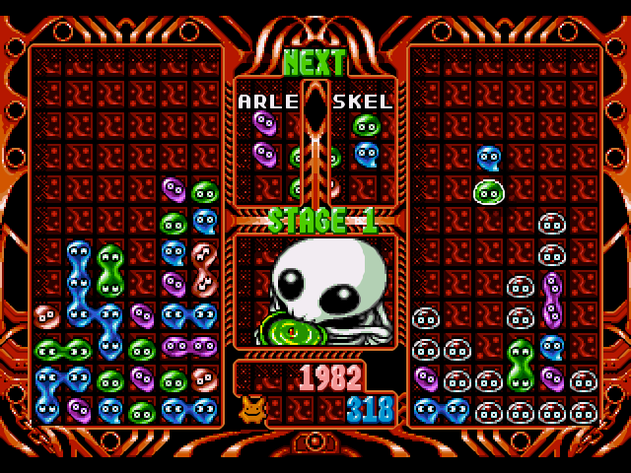
Puzzle Games

Slide 69
Puzzle Games
Characteristics
  In puzzle games, puzzle solving is the primary activity
  Puzzle games usually provide related challenges, variations on a theme
  The types of puzzles offered include pattern recognition, logic, or understanding a process
  The puzzles give the player clues that have to be solved to meet the victory condition

Slide 70
Puzzle Games
Scott Kim’s eight steps in puzzle game design:
Find inspiration
Simplify
Create a construction set
Define the rules
Construct the puzzles
Test
Devise a sequence
Pay attention to presentation

Slide 71
Puzzle Games
What computers bring to puzzles
  Enable nonphysical or awkward moves
  Include computation features
  Enforce the rules
  Undo and record moves
  Structure the experience
  Teach
  Use bells and whistles
  Enable online play

Slide 72
Puzzle Games
Checking the victory condition
  Path to the solution might be different than you planned
  Check the solution, not the way it was reached

Slide 73
What Are Online Games?
Multiplayer distributed games in which the players’ machines are connected by a network
The network can be the Internet or a local area network (LAN)

Slide 74
Advantages of Online Games
Player socializing
  Online games offer opportunities for social interaction
  Most games offer chatting (conversation restricted to typing text)
  More games are including voice communication
  As the creator of an online game, you are a social architect

Slide 75
Advantages of Online Games
Human intelligence instead of artificial intelligence
  If players compete against each other, less AI is needed
  Use NPCs when necessary
    AI-controlled enemies can fight a team of online players

Slide 76
Advantages of Online Games
Online gameplay versus local multiplayer gameplay
  Characteristics
    Multiplayer gameplay can be purely competitive, purely cooperative, or team-based
    In online play, players are usually in separate places
    Local play can be two types
      Local area network (LAN)
        Similar to online play, each has her own screen
      Local play
        Players in the same room using the same equipment, all looking at one screen

Slide 77
Advantages of Online Games
Online gameplay versus local multiplayer gameplay
  Problems with local play
    Must display UI elements for each player
    Can’t hide information from other players
    Limits the number of simultaneous players
  Online play solves the local play problems
    Each player has own screen, information, UI
    Servers can handle thousands of players

Slide 78
Disadvantages of Online Games
Technical issues
  Communication models
    Client/server
      Player runs client and game company runs server
    Peer-to-peer
      Players’ computers communicate directly
  Transmission delay time
    Players with a faster connection could have an advantage
  Dropped and garbled packets cause errors

Slide 79
Disadvantages of Online Games
It’s harder to suspend disbelief
Misbehavior can ruin the game for others
The need to produce content
  Online games earn money through advertising revenue or subscriptions
  To keep players interested, produce new content on an ongoing basis
Online games require more customer service
  Players expect different things from online games

Slide 80
Design Issues for Online Gaming
Arriving players
  Start new matches at frequent intervals
  Provide a lounge for waiting players
  Might need a matchmaking service to form groups
Disappearing players
  Design a fair way to deal with disconnections when they occur

Slide 81
Design Issues for Online Gaming
Real-time versus turn-based games
  Real-time provides more freedom for the player and it’s more immersive
  Turn-based is less immersive and requires:
    Limited number of players in one game
    Time limit on each turn
    Default action occurs if player runs out of time
    Players can do other things while waiting for turn
    In some games all players plan action simultaneously, then server computes the results for each turn

Slide 82
Design Issues for Online Gaming
Chat
  Chat is a mechanism that enables players to send messages to one another
  Chat levels
    Private message to one player
    Message to your team
    Message to the players nearby (in the game world)
    Message to all players in the game at the time
  Profanity filters should be backed up by online customer service reps

Slide 83
Design Issues for Online Gaming
Chat
  Complaint and warning systems
    Complaint button reports offending player to authorities
    Offender can be warned, disconnected, or banned
  Ignoring other players
    Ignoring enables player to stop receiving messages from a specific player
    Player sets ignore, so there’s no staff cost involved
  Moderated chat spaces require an unbiased representative of the company to moderate
  MUST have a strong system to protect children

Slide 84
Design Issues for Online Gaming
Collusion
  Form of cheating in which players who are supposed to be opponents work together in violation of the rules
  Computer enforces rules but software can’t detect certain kinds of collusion such as instant messaging or physical communication outside the game software

Slide 85
Design Issues for Online Gaming
Collusion
  Designing to reduce collusion
    You can’t prevent collusion completely
    You can only try to reduce the effect
Technical security
  Use a secure telecommunications protocol
    Encrypt data
    Use a heartbeat mechanism
    Include unique sequenced serial number in packets

Slide 86
Design Issues for Online Gaming
Technical security
  Don’t store sensitive data on the player’s computer
  Don’t send the player data he isn’t supposed to have
  Don’t let the client perform sensitive operations

Slide 87
Persistent Worlds
The origins of persistent-world gaming
  Since 1978, developers have played text-based persistent worlds called MUDS
  No commercial market for MUDs today
How persistent worlds differ from ordinary games
  Story doesn’t end
  Players can change their roles
  Gameplay is expressive and active, not reactive

Slide 88
Persistent Worlds
The four types of players
  Killers enjoy acting on other players
  Socializers enjoy interacting with other players
  Achievers enjoy acting on the world
  Explorers enjoy interacting with the world

Slide 89
Persistent Worlds
Creating an avatar
  The first thing a player does in a persistent world is create an avatar
  Players maintain profiles that include information such as
    Unique name or handle
    Physical appearance
    History or experience
    Reputation
    Player autobiography

Slide 90
Persistent Worlds
World models
  The five classic world models are:
    Scavenger model
    Social model
    Dungeons & Dragons model
    Player-versus-Player (PvP) model
    Builder model

Slide 91
Persistent Worlds
Avatar death
  Avatar death must be accompanied by a disincentive
  Ways to deal with avatar death:
    Permanent death
    Resurrection with reduced attributes
    Resurrection with some property missing

Slide 92
Persistent Worlds
The player-killer (PK) problem
  It’s more interesting to fight another player than an NPC
    Players carry better loot than NPCs
    It’s a social experience
    Players fight better than AI opponents
  The Ultima Online experience
    Without imposed limitations, players preyed on each other

Slide 93
Persistent Worlds
The player-killer (PK) problem
  Justice mechanisms alternatives to regulate PvP
    No automated regulation
    Flagging of criminals
    Reputation systems
    PvP switch
      Only consensual fights allowed
    Safe games; no PvP allowed
  Faction-based PvP enables players to attack members of enemy factions but not members of their own faction

Slide 94
Persistent Worlds
The player-killer (PK) problem
  The bottom line on player killing:
    It’s a fantasy world, it needs to be fun for everyone
    People pay to play
      Their cash expenditure matters
The nature of time
  In single-player games, time can be paused, sped up, or skipped
  In online games, time must run at the same pace for everyone

Slide 95
Persistent Worlds
Persistent world economies
  Designing and tuning the economy in an online game is difficult
  Players should not be able to create something for nothing
  As with all other games with an economy, do not create any system that allows players to generate runaway profits

Slide 96
Recommended reading
A good fiction book that revolves around persistent online worlds is Ready Player One by Ernest Cline (2011).
There are plenty of great ideas for online gameplay in his book!

